Slide 1
Introduction to
IoT Architecture

Slide 2
What is IoT?
The Internet of Things (IoT) is a system of interrelated computing devices, mechanical and digital machines, objects, animals or people that are provided with unique identifiers and the ability to transfer data over a network without requiring human-to-human or human-to-computer interaction.
The Internet of Things is the concept of connecting any device (so long as it has an on/off switch) to the Internet and to other connected devices.

Slide 3
Applications of IoT
Smart home 
Smart Wearables
Connected Cars
Smart cities
IoT in agriculture
Smart retail
IoT in healthcare
IoT in Poultry and Farming

Slide 4
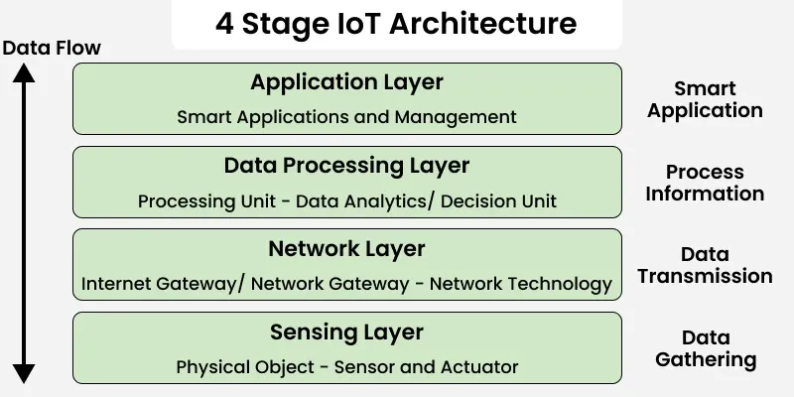

Slide 5
1. Perception / Sensing Layer
The first layer of any IoT system involves “things” or endpoint devices that serve as a connection between the physical and the digital worlds.
Perception refers to the physical layer, which includes sensors and actuators that are capable of collecting, accepting, and processing data over the network.
Sensors and actuators can be connected either wirelessly or via wired connections.

Slide 6
2. Network Layer
Network layers provide an overview of how data is moved throughout the application.
Transmits collected sensor data to processing platforms securely using Data Acquiring Systems (DAS) & Internet/Network gateways.
Supports device-to-device and device-to-server communication.
Handles addressing, routing and data forwarding.
Technologies - Wi-Fi, Bluetooth, Zigbee, LoRaWAN (Long Range Wide Area Network - a low-power wireless protocol for Internet of Things (IoT) devices )
Uses Ethernet and satellite networks, Supporting Devices, Routers and switches

Slide 7
3. Data Processing Layer
The processing layer is the brain of the IoT ecosystem.
Data is analyzed, pre-processed, and stored here before being sent to the data center, where it is accessed by software applications that monitor and manage the data as well as prepare further actions.
Uses IoT cloud platforms, Data lakes and warehouses
Utilizes Stream processing and machine learning engines
Generates predictive alerts and reports; Anomaly detection signals; Decision rules for automation

Slide 8
4. Application Layer
User interaction takes place at the application layer, which delivers application-specific services to the user.
Provides interfaces to monitor and control IoT devices remotely.
Leads to Remote device management, Real-time condition monitoring, Integration with enterprise applications
Displays visual analytics through dashboards and charts.
Triggers automated actions based on processed data

Slide 9
